Slide 1
CineNest.ai
AI POWERED INTEGRATED FILM PRODUCTION SYSTEM

Slide 2
Team members
Muhammed Fahad E V
Adhil Rifayin k s
Abhinav p
Deethu p

Slide 3
Introduction
Problem
Statements
Current Reality
Features
Impact
Workflow Automation
Conclusion
Table of Contents

Slide 4
Introduction-
Film making is an art , and making films take contributions from hundreds of people
The film industry has always been driven by creativity, but behind every scene lies a complex web of planning, logistics, and coordination.
Today, many production teams still rely on fragmented tools and manual workflows — leading to delays, miscommunication, and budget overruns.
CineNest.ai is here to change that.
5

Slide 5
Problem Statements
Pre Production
Production
Post Production
Script breakdown
Scheduling
Scouting
Crew Assignment
On-set coordination
Updates
Budget tracking
Distribution Monitoring
Investor updates

Slide 6
Current Reality
Miscommunication (crew misses updates)
Overspending (no real-time budget control)
Zero Transparency (producers & investors blind until late)
Technical Limitations

Slide 7
CineNest.ai Features
Your AI Production Assistant
Pre-Production Automation: AI script breakdowning, Scheduling,Location Scouting, crew assignment
On-Set Operations: crew coordination, schedules, notifications
Real-time production status updates
Budget Tracking,Budget analysis
Distribution: ticket sales
Status logs: daily update
Ai booking for locations
Legal advisor
Reports to investors

Slide 8
IMPACT
By using our CineNest.ai we can make film production more efficient
Making contracts in minutes
Predicting accurate budgets and resources
Transparent for film production company
Helpful for indie films with no prior experience in film production

Slide 9

Workflow Automation

Slide 10
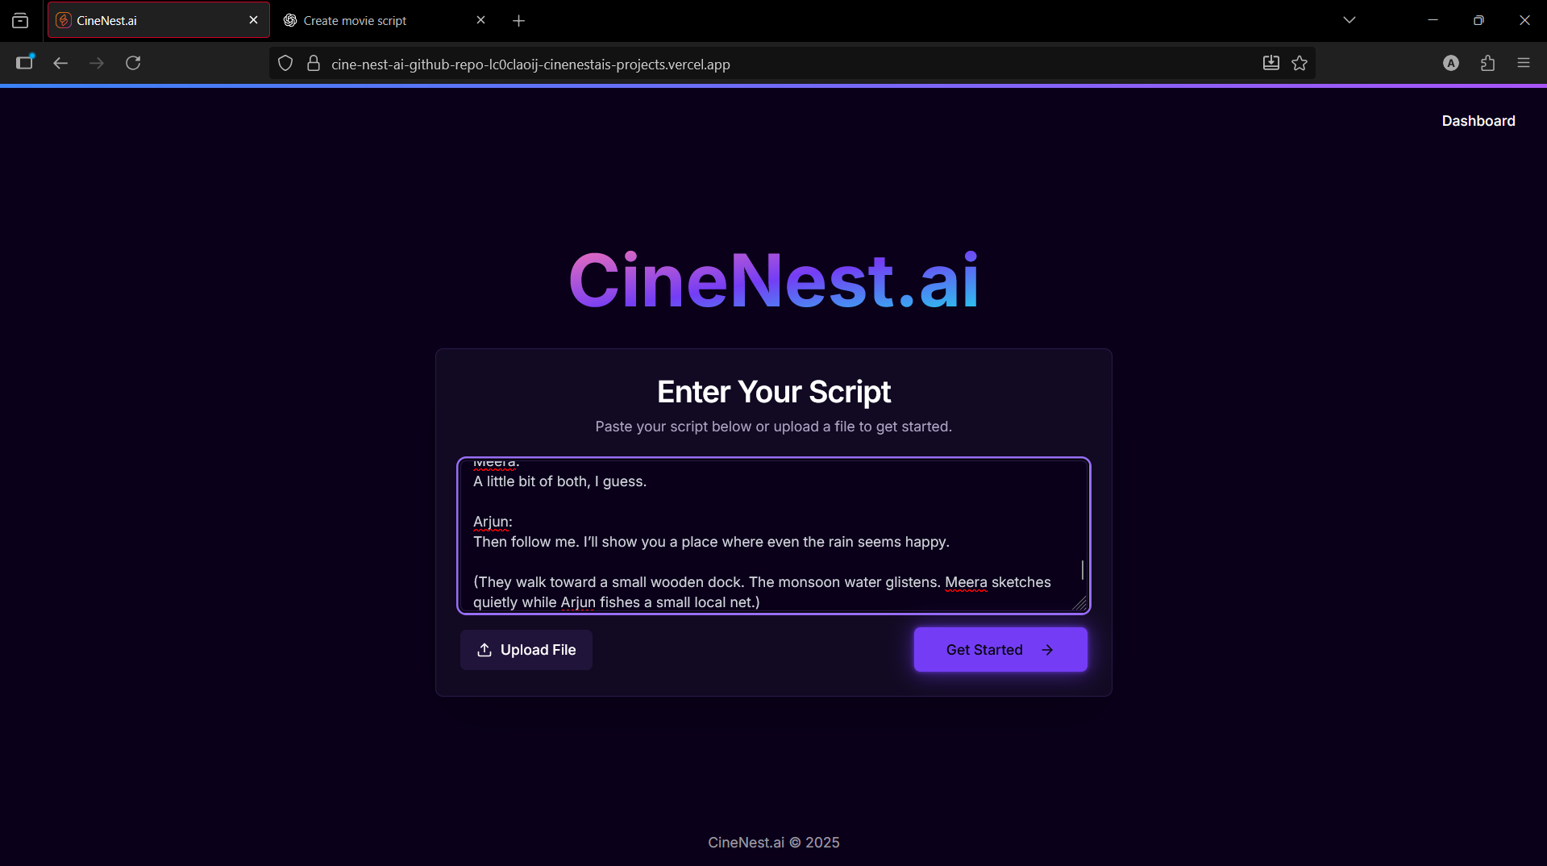

Slide 11
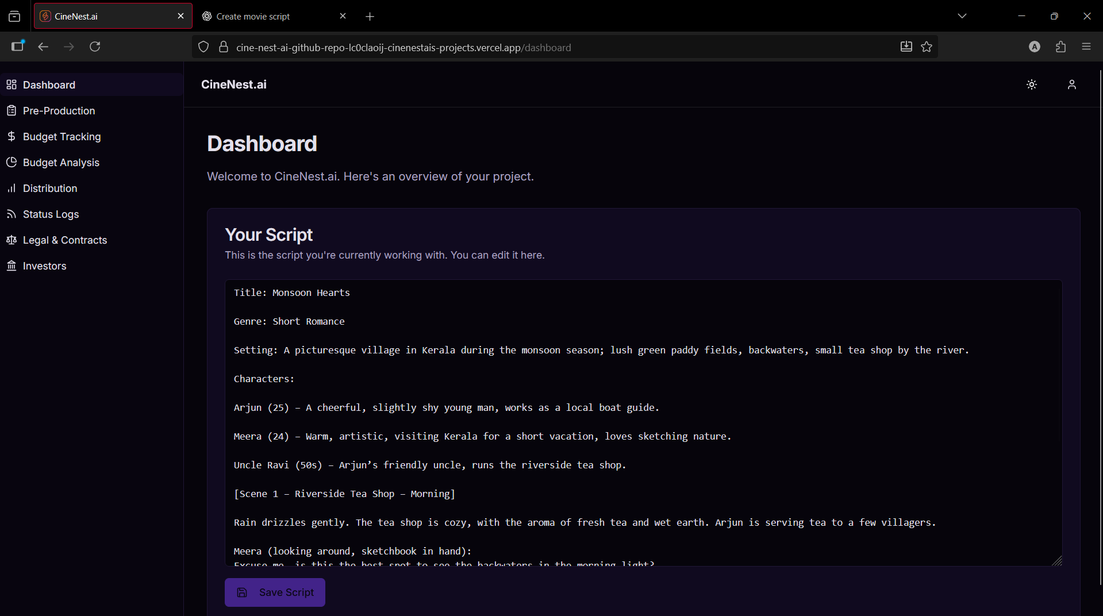

Slide 12
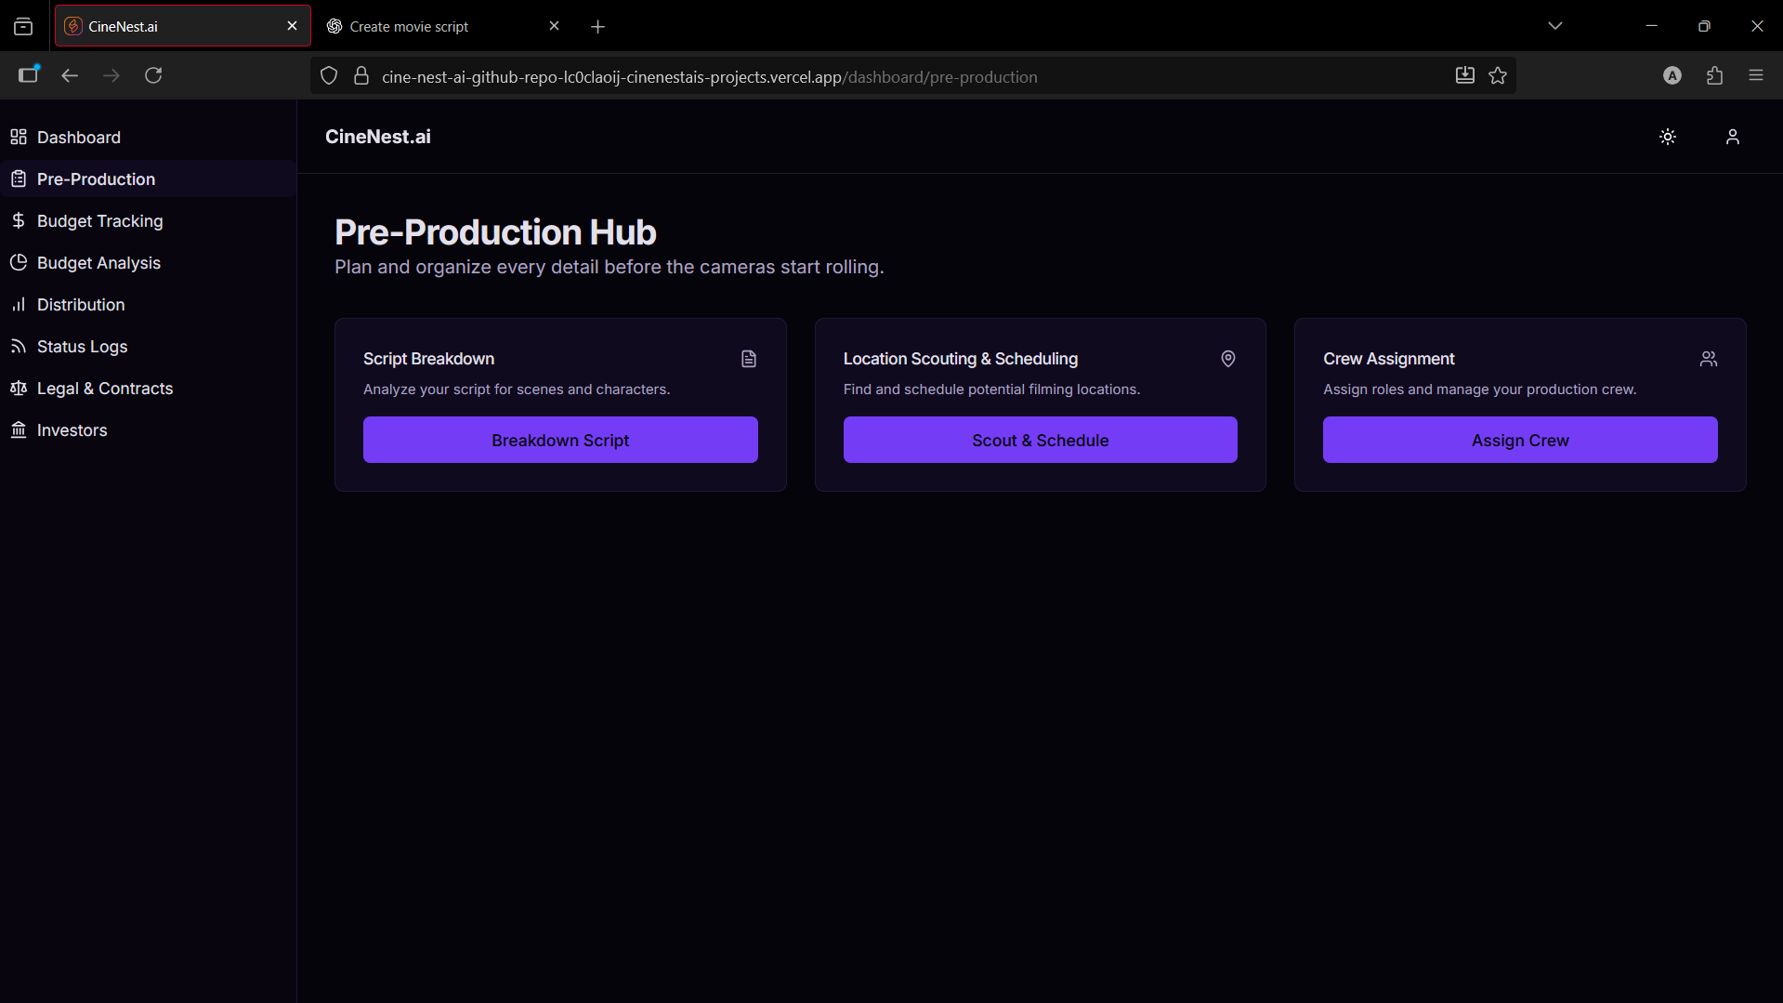

Slide 13
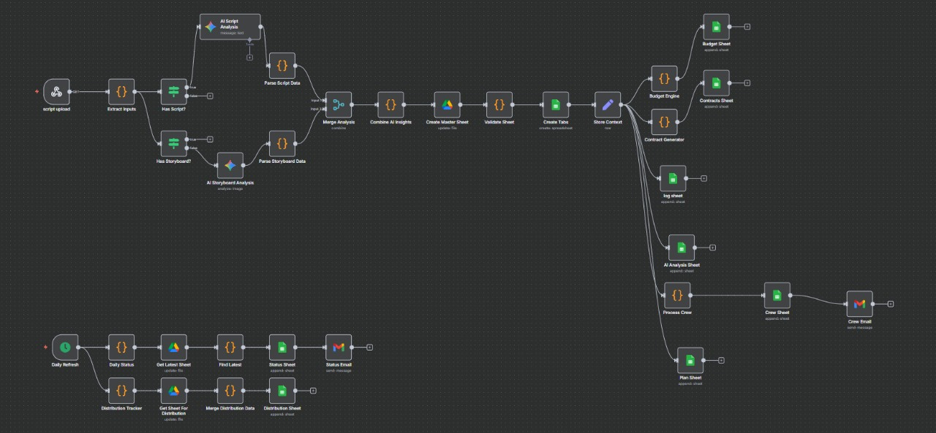

Slide 14
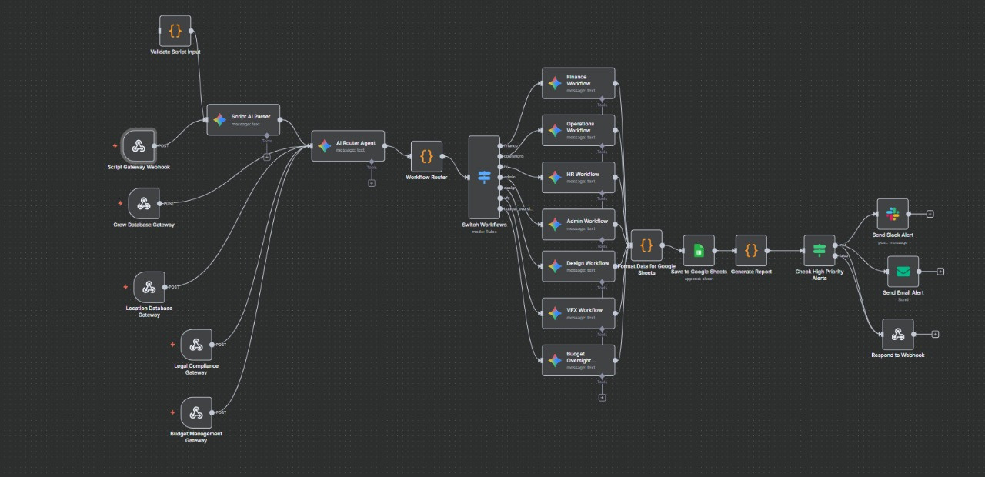

Slide 15
CONCLUSION
Transforming film making into a fully automated , transparent and efficient working environment

Slide 16

The End
THANK YOU FOR LISTENING

